Slide 1
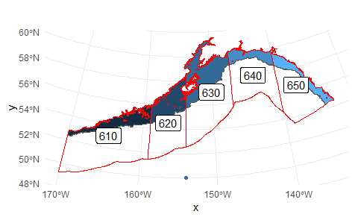
NEP 10km model (monthly)
ROMS runs:
Hindcast (2000-2020)
“Historical" run (1980-2014)
GFDL ssp126 projection (2015-2099)
GFDL ssp585 projection (2015-2099)
Depth ranges:
Surface (from 0 to 10 m)
Bottom (bottom to 10 m from bottom)
Midwater (10 m to 10 m from bottom)
Each management area to:
1,000 m isobath
300 m isobath

Slide 2
GOA Indices
Variable | NEP name
Ammonium | NH4
detritus concentration | Det
euphausiid concentration | Eup
euphausiid net production rate | prod_Eup
Iron concentration | Iron
Large copepod concentration | NCa
Large copepod production rate | prod_NCa
Large microzooplankton concentration | MZL
Large microzooplankton production rate | prod_MZL
Large phytoplankton concentration | PhL
Large phytoplankton production rate | prod_PhL
Time-averaged f ratio for large phytoplankton | frat_PhL
Nitrate | NO3
Salinity | salt
Small copepod concentration | Cop
Small copepod net production rate | prod_Cop
Small microzooplankton concentration | MZS
Small microzooplankton production rate | prod_MZS
Small phytoplankton concentration | PhS
Small phytoplankton production rate | prod_PhS
Time-averaged f ratio for small phytoplankton | frat_PhS
Temperature | temp
Vertically interpolating variables at each rho point (1 m intervals)
Summarizing (1) vertically and (2) horizontally
Averaged across depth and area
Summed across depth then averaged across area (to get standing stock biomass estimates)

Slide 3
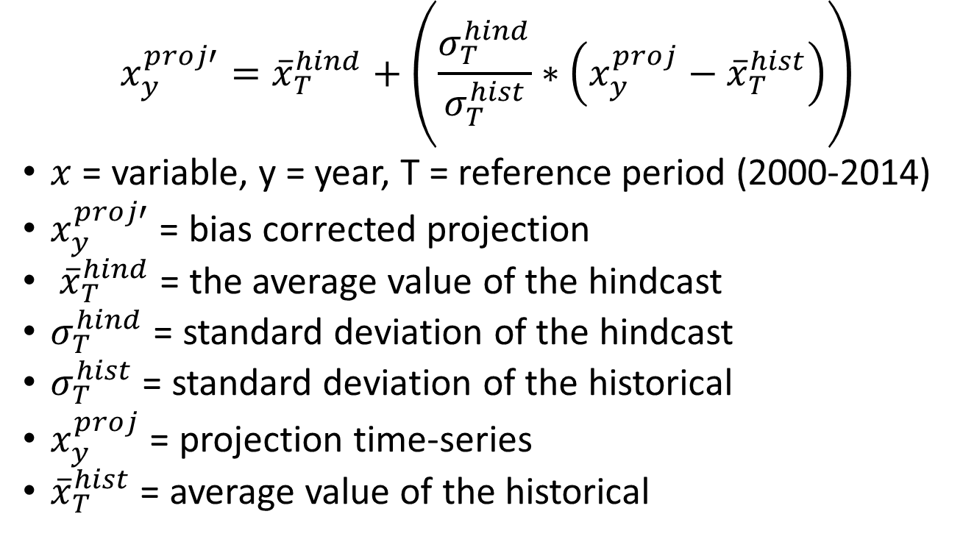
Delta correction (log?)
$$x_{y}^{proj′}={\overline{x}}_{T}^{hind}+\left(\frac{σ_{T}^{hind}}{σ_{T}^{hist}}∗\left(x_{y}^{proj}−{\overline{x}}_{T}^{hist}\right)\right)$$
$x$ = variable, y = year, T = reference period (2000-2014)
$x_{y}^{proj′}$ = bias corrected projection
${\overline{x}}_{T}^{hind}$ = the average value of the hindcast
$σ_{T}^{hind}$ = standard deviation of the hindcast
$σ_{T}^{hist}$ = standard deviation of the historical
$x_{y}^{proj}$ = projection time-series
${\overline{x}}_{T}^{hist}$ = average value of the historical

Slide 4
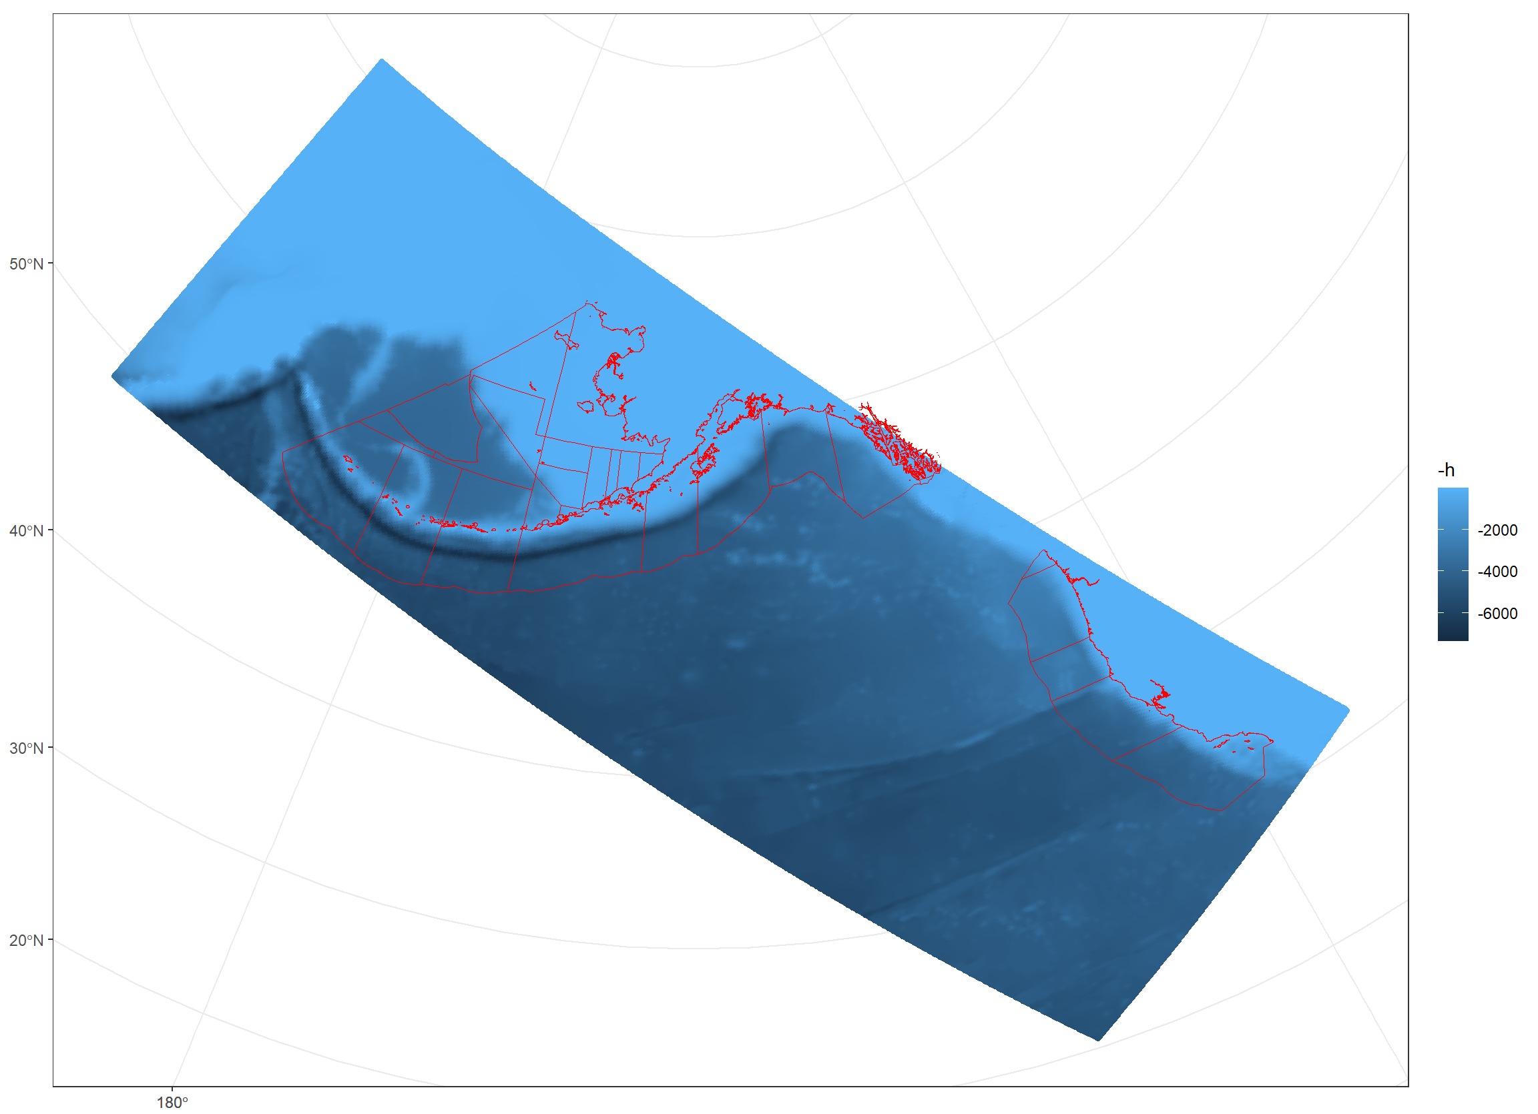
Mapping ROMS to GOA
NMFS areas are the common spatial unit for most GOA-CLIM biological models

Slide 5
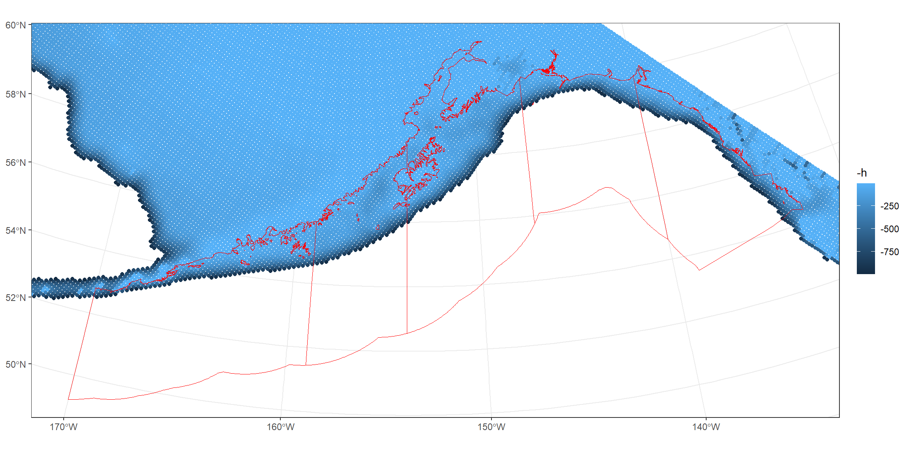
Mapping ROMS to GOA
Cropping to depths < 1000 m (ROMS h)

Slide 6
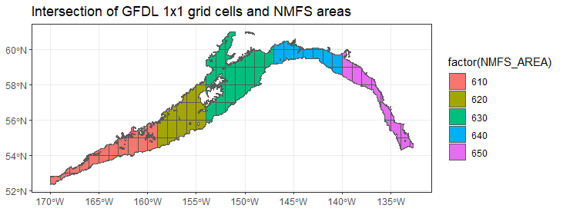
pH from ESM output (Pcod)
Surface and bottom pH from GFDL
historical
SSP-126
SSP-585
Surface and bottom: shallowest and deepest slice of ESM, respectively

Slide 7
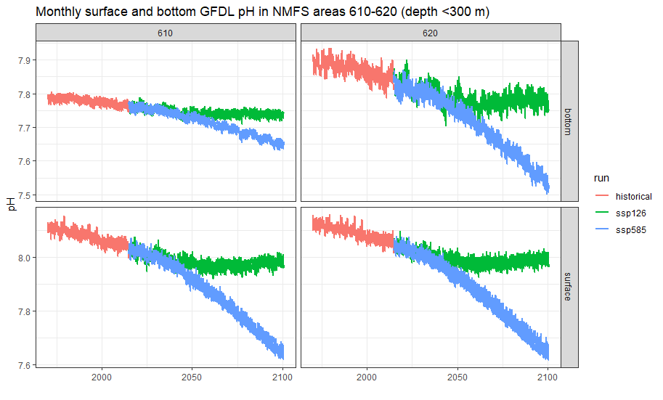

Slide 8
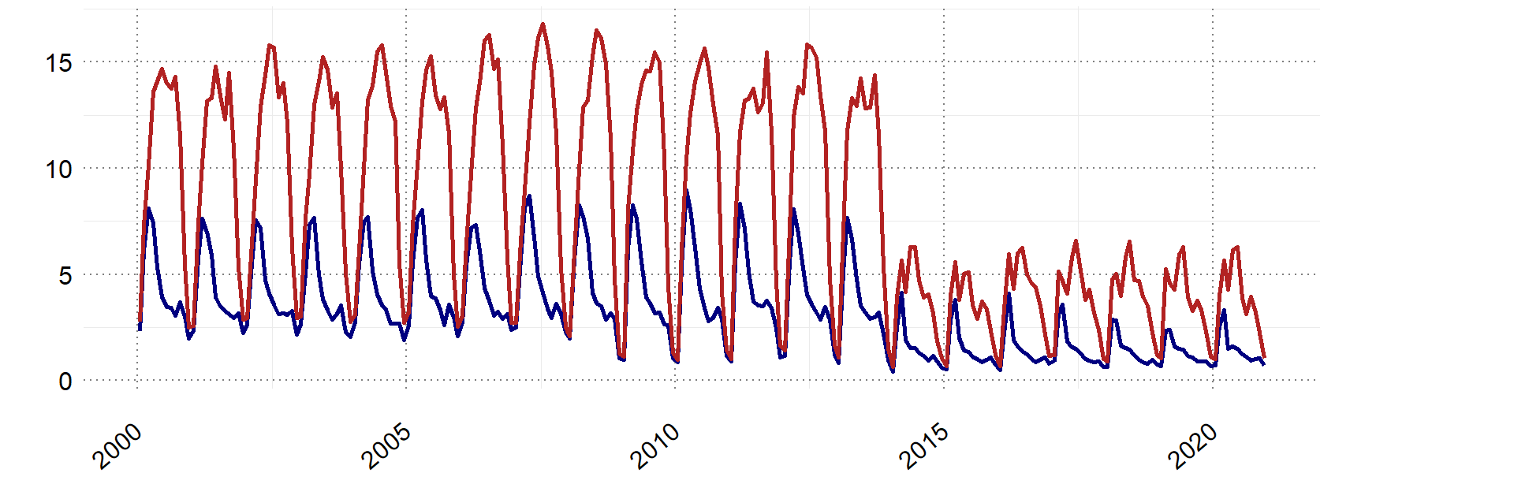
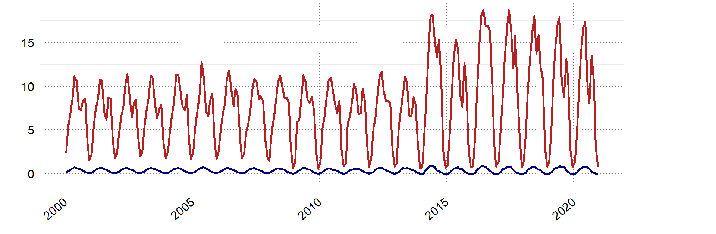
Some issues / caveats
ROMS:
Hindcast: around 2014 something changes for some vars
Not visible in historical runs or projections
MZS
Prod_PhS

Slide 9
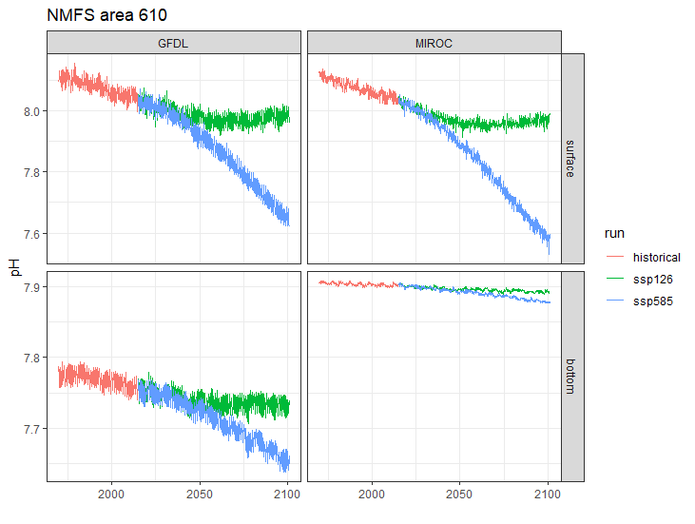
Some issues / caveats
ESM:
Bottom pH very different between ESMs
Possibly due to different vertical structure (or I am grabbing the wrong data…)

